Slide 1
ADA Boost Regressor
- A Meta-estimator USED IN ENSEMBLE LEARNING FOR REGRESSION TASKS.
Boosts the accuracy of the original learning algorithm by combining multiple weak learners into a strong classifier.
Focus more on data points that were misclassified in previous rounds

Slide 2
Ada Boost - Advantages
AdaBoost significantly enhances the performance of weak learners
By focusing on misclassified samples, it builds a strong classifier that often outperforms single models
Helps reduce bias by combining multiple weak learners.
Can be applied to both classification and regression tasks.

Slide 3
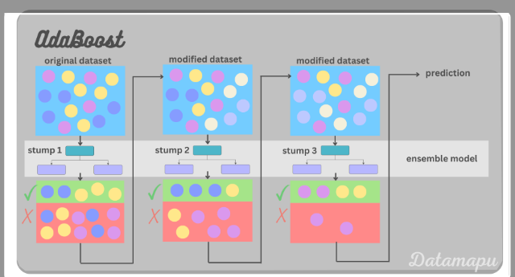
Ada Booster – Pictorial Representation

Slide 4
Derivation of R value with different parameters (Verified for Insurance predictor dataset)
Base_estimator | Learning_rate | Loss | N_estimators | Randon_state | R Vaue
None | 1.0 | Linear | 100 | 0 | 0.844
None | 1.0 | square | 50 | 0 | 0.518
None | 1.0 | Square | 100 | 0 | 0.466
None | 1.0 | Exponential | 50 | 0 | 0.629
None | 1.0 | Exponential | 100 | 0 | 0.538
None | 1.0 | Linear | 50 | 0 | 0.844

